Slide 1



Large Language Models for the Study of Non-WEIRD Populations
C. Mónica Capra
Augusto González-Bonorino
Matthew Feng
Emilio Pacheco

Slide 2



What are Large Language Models (LLMs)?
LLMs, like ChatGPT, are AI systems that can predict and generate human-like text based on patterns they've learned from training on vast amounts of data.
They are prediction models that, given a sequence of words ("tokens"), predict the statistically most likely completion.
Examples…
Highlight new capabilities …..
How would you handle a difficult customer?
I would handle a difficult customer with empathy, professionalism, and a commitment to providing excellent customer service.
I believe that treating customers with respect, understanding, and fairness is essential for the long-term success and reputation of a business.
Hi, I am a Classical economist bot
Notes:
Architectures: Transformer-based (DNN); RNN; GAN

Slide 3

LLMs as Human Subjects
We can use LLMs as agents that can respond to experimental instructions.
This is similar in spirit to the idea of utilizing ABMs, but the researcher does not pre-program behavior.
John Horton’s Homo Silicus: “A computational model of human behavior that does whatever the model predicts is statistically probable.”

Slide 4
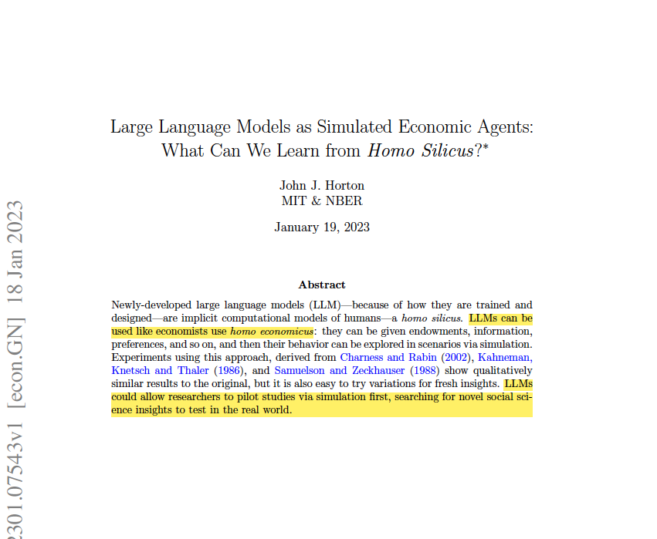
Notes:
BACKGROUND

Slide 5



Non-WEIRD Populations
"The human species is not a single, monolithic entity, but rather a diverse array of distinct populations, each with their own unique cultural practices, beliefs, and lifestyles. Studying these populations, and how they differ from one another, is essential for understanding the evolution of human nature, and for developing a more nuanced and accurate understanding of human biology and behavior." Joseph Henrich
Notes:
WHY?

Slide 6

Research Question
Since can create "homo silicus" – artificial agents with decision-making profiles modeled after a specific culture – we ask:
What can LLMs reveal about the preferences and behaviors of non-WEIRD populations?
Notes:
WHAT?

Slide 7
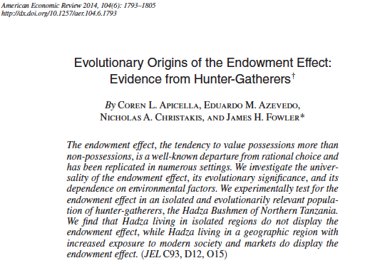
The Endowment Effect
Notes:
PROOF OF CONCEPT: This “homo silicus” answers questions to measure the endowment effect – the tendency to value possessions more than non-possessions.

Slide 8
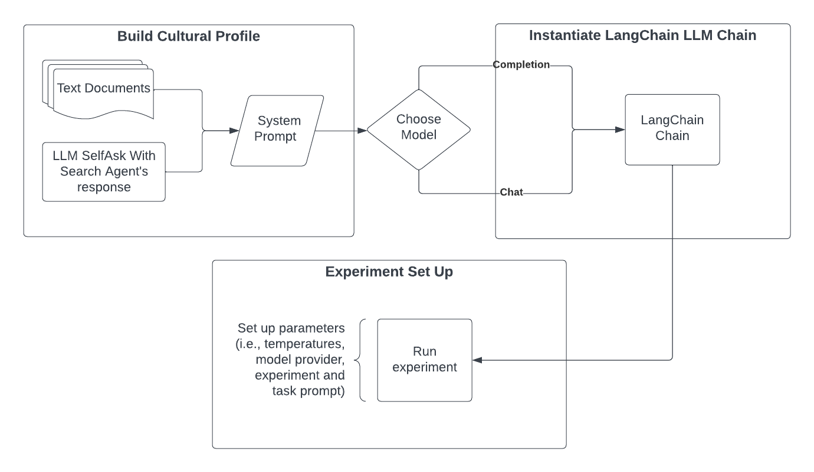
Methodology

Slide 9
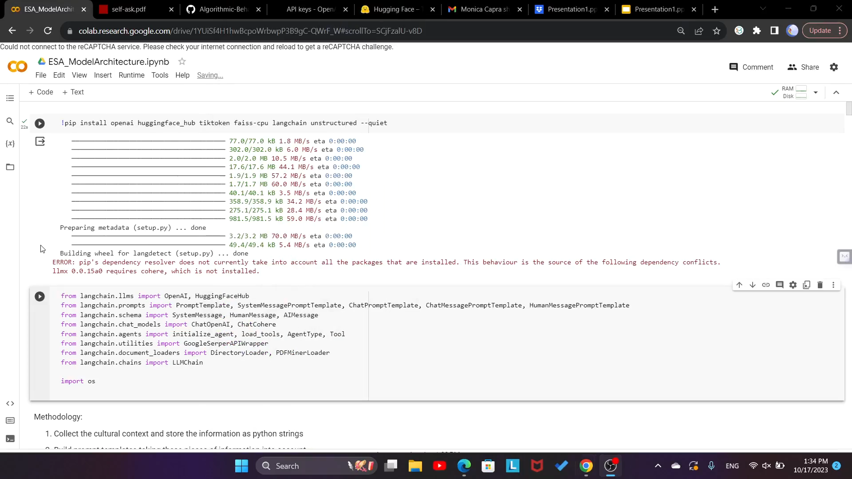
Create a
Cultural Profile
We used Python to create a LangChain agent (an LLM agent with access to tools) to generate a cultural profile for a member of the Hadza.
LangChain agent has access to Google search through Google Serper API.
Notes:
a type of artificial intelligence (AI) agent that is composed of multiple machine learning models, or "layers," that are stacked together to perform a specific task.

Slide 10
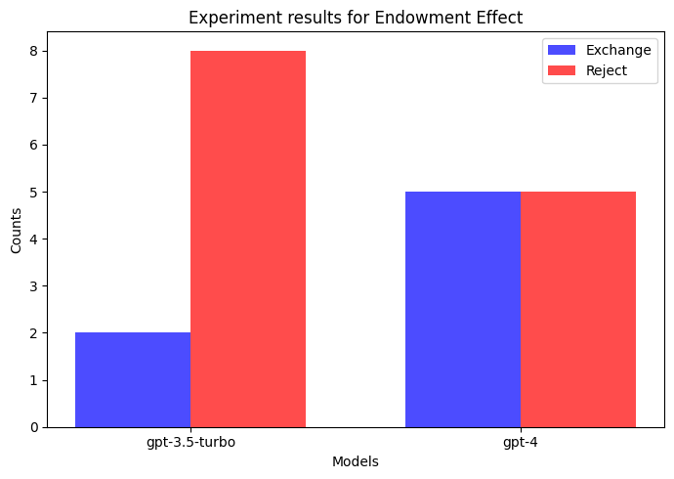
Homo Silicus & Economic Decisions
System prompt: specifies the “Persona”
completion_system_prompt = f"You are a member of a tribe with the following characteristics: {tribe_prof}"
Experiment prompt: specifies the decision environment
experiment = f"You are given a mug while waiting for a researcher to call your name. When you are called, he offers to exchange your mug for a cookie.”
Subject task: specifies the choice set
subject_task = "Do you exchange the mug or reject the cookie? You must reply in one word with either 'exchange' or 'reject' and explain why you chose that. For example, 'I reject' or 'I exchange'"
Notes:
Apicella et al. found that The results of the pooled data are shown in Figure 2, panel A. In the LE (low exposure to market) group, the probability of trading the endowed item is M = 0.53, SE = 0.05. The 95 percent confidence interval is [0.43, 0.64]. For the market integrated it is 0.25 – yellow band is the 95% CI of estimated probability of exchange.

Slide 11
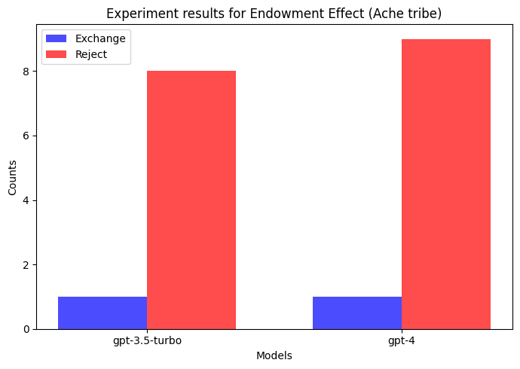
Experiments with other Tribes
Notes:
Ache behave quite different from the Hadza. Noone has studied the endowment effect, as far as we know, but
In the Tsimane and Ache cases, for instance, there are no rejections of offers below 20 percent, although there were several low offers. The rejection rate for all other offers is also zero
At the other end of the rejection scale, Hadza responders rejected 24 percent of all proposer offers and 43 percent of offers at 20 percent and below.

Slide 12
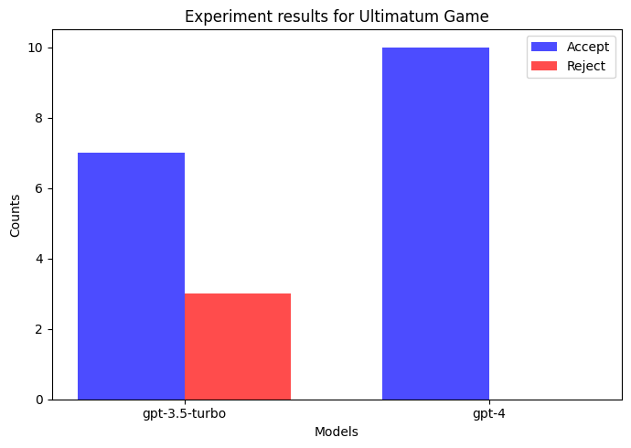
Homo Silicus & Economic Decisions
Experiment prompt: specifies the decision environment
"You are randomly chosen to be a recipient of an offer to split $10 with someone else. You are offered USD $2. If you reject the offer, you and the other get nothing. If you accept you get the offer and the other gets the rest"
Subject task: specifies the choice set
"Do you accept or reject the offer? Reply in one word with either ‘accept’ or 'reject’”
Notes:
This compares the treatment in Henrich et al 2001. With experimenter imposed “low” offer of 20%. The Hadza small groups (LE – low exposure) 31%. Without experimenter imposed low offer Hadza responders rejected 24 percent of all proposer offers and 43 percent of offers at 20 percent and below.
how good are these results? Someone please check with literature.
Our main contribution will be the methodology to help organize motivated researchers. We haven’t run a particularly sophisticated program/experiment but we put a lot of time into organizing this process into a linear sequence of steps. If we are happy with the current results and code, I will draft a flow chart tomorrow.
The ultimatum game prompt from the document does not specify what the offer for the LLM to reject or accept. Is this an error? If so I need to rerun the experiments for that game

Slide 13

Takeaways
We created a LangChain agent ”Homo Silicus” representing the Hadza
We tested Silicus’ endowment effect and “choices” an Ultimatum Game as a proof-of-concept
We show that LangChain Silicus can reveal latent preferences of populations living in small-scale societies that are hard to study, giving a more complete picture of human nature.
Notes:
a type of artificial intelligence (AI) agent that is composed of multiple machine learning models, or "layers," that are stacked together to perform a specific task.

Slide 14
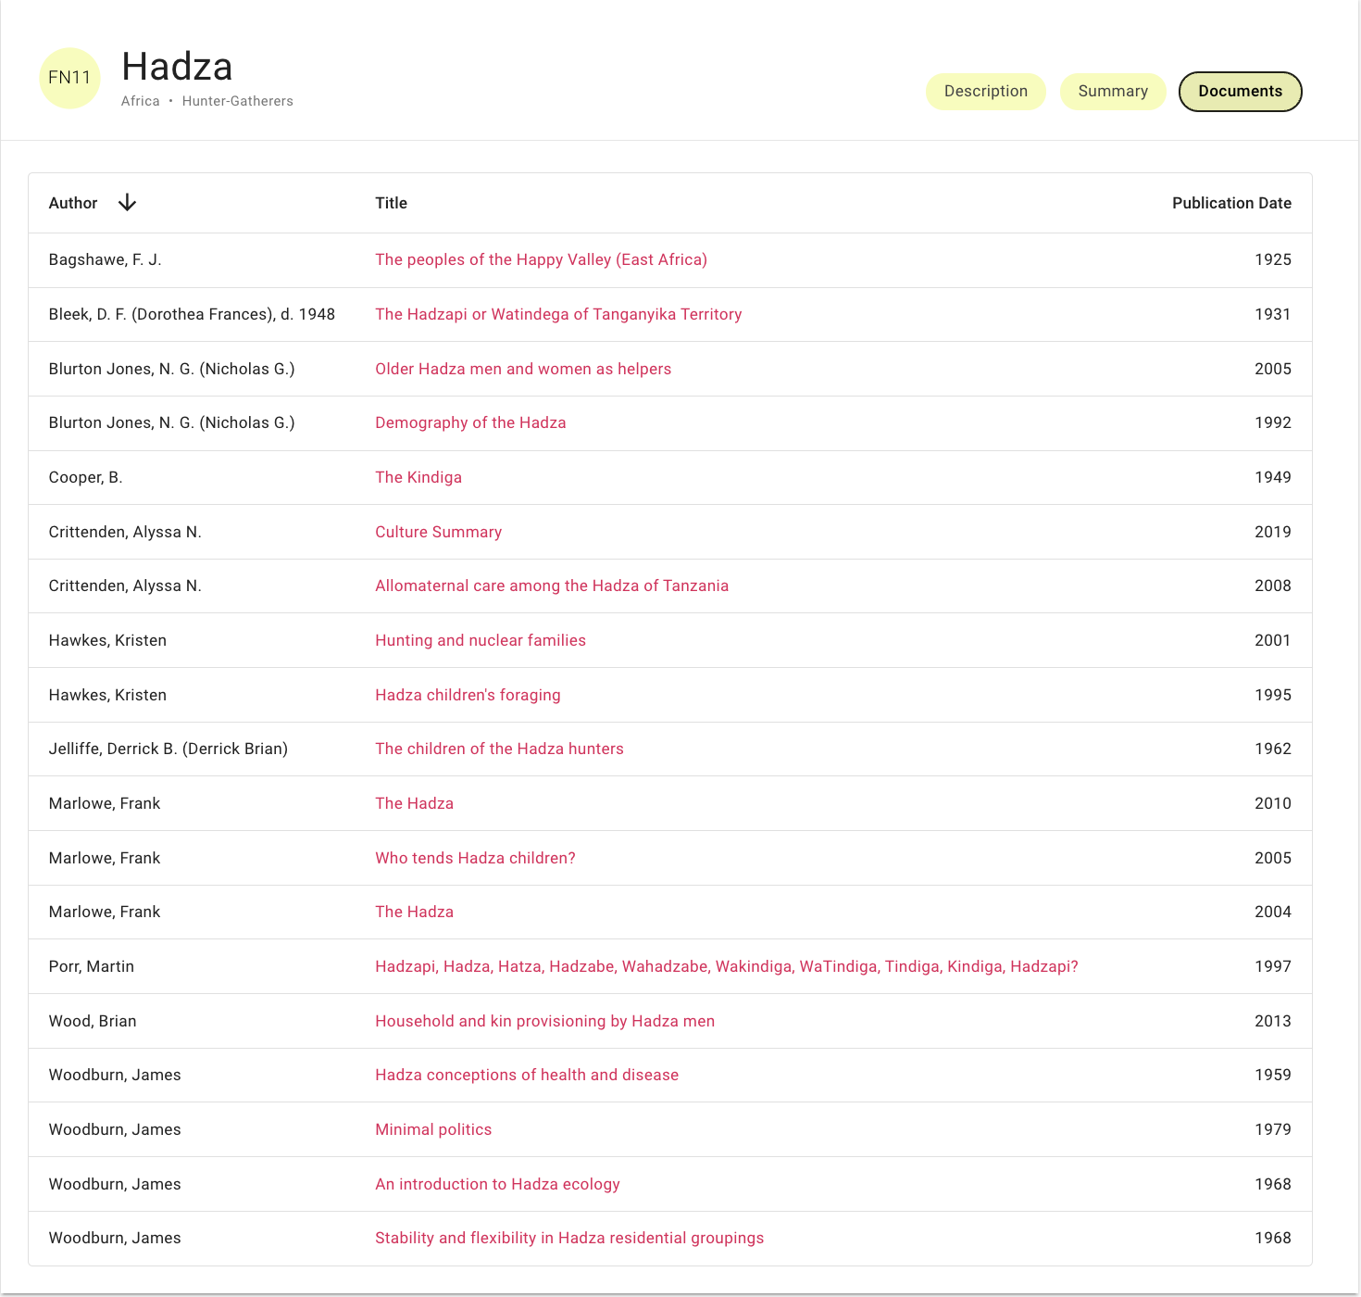


Limitations
Temperature affects model behavior
Google search for the context – information may not be available
Augment context with RAG (potential sources: eHRAF - Cultural information for education and research - and Wikipedia)
Notes:
Twaitsha - A small nomadic group in southern Angola/Namibia known for click language. No evidence Henrich studied them.

Slide 15
A Case for Homo Silicus
Experiments reveal Homo Silicus’ preferences. Helpful for piloting experiments.
We can use experimental economics games to compare LLM architectures.
AI researchers can benefit from utilizing economic experiments.
Notes:
Parallel to the way experiments helped neuroscientists in identifying brain regions that process strategic/market decision-making.

Slide 16
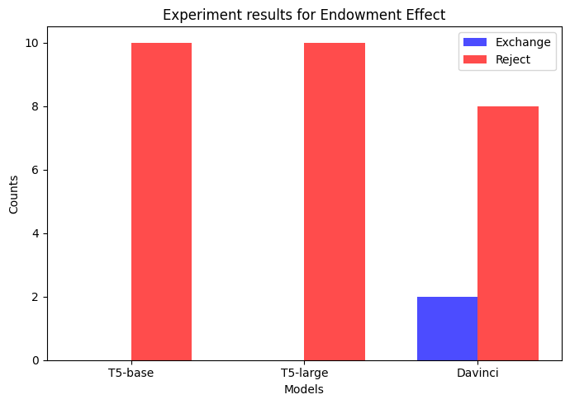
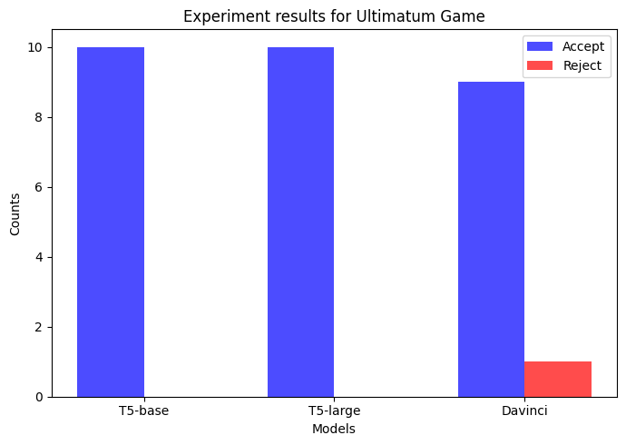
Revealing Latent Biases
Chat
Completion
Notes:
how good are these results? Someone please check with literature.
Our main contribution will be the methodology to help organize motivated researchers. We haven’t run a particularly sophisticated program/experiment but we put a lot of time into organizing this process into a linear sequence of steps. If we are happy with the current results and code, I will draft a flow chart tomorrow.
The ultimatum game prompt from the document does not specify what the offer for the LLM to reject or accept. Is this an error? If so I need to rerun the experiments for that game
Davinci hallucinates more than T5 (evidenced by the experiments for which Davinci and GPT-3.5 failed to provide an answer)

Slide 17
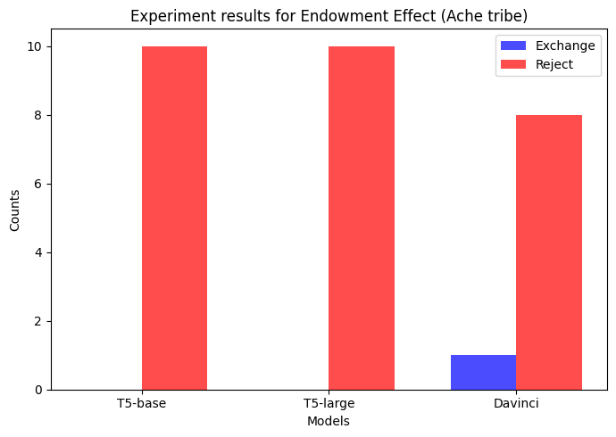
Experiments with other Tribes
The Aché
Notes:
Ache behave quite different from the Hadza. Noone has studied the endowment effect, as far as we know, but
In the Tsimane and Ache cases, for instance, there are no rejections of offers below 20 percent, although there were several low offers. The rejection rate for all other offers is also zero
At the other end of the rejection scale, Hadza responders rejected 24 percent of all proposer offers and 43 percent of offers at 20 percent and below.

